Slide 1
UCR BUDGET AND FINANCIAL FUNDAMENTALS
Town Hall
December 9, 2024
Notes:
Gerry

Slide 2
CAMPUS BUDGET OVERVIEW
Revenue and Expenses in FY23-24
~$1.3 billion total budgeted revenues and expenditures
Core Budget plus Student Fees, C&G, Gifts, Sales & Service, and Auxiliaries
~$721 million core budgeted revenues and expenditures
Core used to fund the teaching and research operations for the campus
Projected Revenue and Expenses for FY24-25
~$1.3 billion total budgeted revenues and expenditures
Core Budget plus Student Fees, C&G, Gifts, Sales & Service, and Auxiliaries
~$758 million core budgeted revenues and expenditures
Core used to fund the teaching and research operations for the campus
Notes:
Stephanie

Slide 3

CAMPUS BUDGET OVERVIEW
FY24 All Funds Revenue and Expenditures
Salaries & Benefits make up 73% of total expenses
Notes:
Stephanie

Slide 4
CAMPUS BUDGET OVERVIEW
FY24 Core Revenue and Expenditures
Salaries & Benefits make up 82% of total expenses
Notes:
Stephanie

Slide 5
CAMPUS BUDGET OVERVIEW
UCR Major Revenue Streams over time
HEERF Funds
In thousands
Notes:
Gerry

Slide 6
CAMPUS BUDGET OVERVIEW
UCR Major Core Revenue Flows
Inflow
Student Tuition (excludes Self- Supporting)
Driven by enrollment
Regent Tuition Increases approvals
State Funding (through UCOP)
Driven by State
Includes set-asides*
Non-Resident Tuition
Driven by enrollment of out-of-state and international students
Waived for about 50% of students per UCOP policy (CA HS graduates, etc.)
F&A
Distributed through UCOP Rebenching
Based on Budgeted Student FTE
Reduced by student discounts
Driven by Contract and Grant activity
Realized rate is about 50% of the approved rate
Outflow
Org Base Budgets
Undergrad Financial Aid and Scholarships
Graduate Student Stipends and Fellowships
Salary and Benefits Cost Increases
Tuition Allocations to Colleges and Schools
F&A Distribution Funding, Faculty Start-ups
Debt & Lease Payments
Campus-wide Projects (Banner, Financial System, UC Path)
Special Decisions
*See Slide 11 for set aside details
Notes:
Stephanie

Slide 7
CAMPUS BUDGET OVERVIEW
UCR Major Core Variables - Revenue
Tuition Increases
(excludes Self-Supporting)
Tuition and Non-Resident Tuition provide ~49% of our core revenues
State Funding Increases
State funding provides ~47% of our core revenues
Student Enrollment Growth
Additional tuition & state funds (offset by costs)
Tuition and Non-Resident Tuition changes require Regental approval
Based on STATE FTE enrollment (average unit loads) and defined set-asides
Enrollment of self-supporting Masters & non-residents provide additional revenue
Negotiated by UCOP and CA Legislature, Governor
Based on Budgeted FTE, with occasional true-ups to actuals
Limited by current human and capital infrastructure
01
02
03
Notes:
Gerry

Slide 8
CAMPUS BUDGET OVERVIEW
Major Core Variables - Revenue
UCOP Rebenching Model
The UCOP process to allocate state funds to each of the campuses based on student enrollment (FTE of CA Residents)
UCOP also allocates state funds to “set-asides” (see slide #11)
UCOP determines model and is implementing changes such as 1.5x weighting for UG students from LCFF high schools, reducing HS weights outside of medicine and veterinary med down to 2.5, and grad student true-up to remove aspirational growth at some campuses.
FY24 was the last year UCR received funding to achieve the 95% level of the UC average for state funding per unweighted student. UCR received a total of $22.9M
04
Notes:
Gerry

Slide 9
CAMPUS BUDGET OVERVIEW
Major Core Variables - Expenses
UCOP Assessment
Total assessment to UCR in FY24-25 is ~ $27M
Fixed Cost Increases
Salary and Benefits for faculty and staff are the main drivers as well as other mandates from contract increases (see next slide for cost details)
UCOP determines model
UCOP “charges” each campus an assessment fee to fund their central operations and has also transferred expenses previously covered by their budget as separate charges to campuses (UCDC, Library costs, etc.)
This is how UCOP gets their annual operating budget
05
06
Notes:
Stephanie

Slide 10
CAMPUS BUDGET OVERVIEW
UCR’s FY25 State Permanent Budget with Set-Asides Noted
Description | UCR Amount | Location
Agricultural Exp Stations (Ag Ops) | $38,368,323 | UCB, UCD, UCR (set-aside currently adjusted for inflation)
SAPEP | $689,323 | All campuses (set-aside currently adjusted for inflation)
SAPEP – Rotating | $1,600,250 | All campuses (Perm funding reallocated between campuses every 3 years)
Fixed Cost Set-Aside | $15,000,000 | Rebenching Campuses (all campuses except UCM and UCSF)
Unweighted Bud Enrollment (95% UC avg) | 22,945,794 | UCR, UCSC, UCSB
SOM | $42,000,000 | UCR Only
Multi-Campus Labor Center Initiative (CHASS) | 500,000 | UCD, UCI, UCR, UCSC (UCB, UCLA, UCM received $3M each)
Improve Grad Rates | $1,600,000 | UCM, UCR, UCSC, UCSB
Dream Loan Program | $491,000 | All campuses
Student Basic Needs | $1,422,000 | All campuses
Student Rapid Rehousing | $325,000 | All campuses
Student Mental Health | $2,221,000 | All campuses
Former Foster Youth | 734,000 | All campuses
Carceral System Impacted | 424,000 | All campuses
Undocumented Student Services | 594,000 | All campuses
Support for Students with Disabilities | 150,000 | All campuses
Common Learning Management System | 83,100 | All campuses
Faculty Hiring Incentive Program | $1,360,000 | All campuses (3-year Perm funding reallocated between campuses for each award cycle)
USAP Financial Aid Program/Summer FA | $13,546,000 | All campuses (Perm funding reallocated between campuses every year)
UCR State Funding from set-asides | $144,053,790
UCR’s State Funding based on Enrollment | $265,999,657 | Rebenching Funds which are adjusted for inflation with state funds
UCR’s Total FY25 State Perm Budget* | $410,053,447 | 95% or $390M is considered Core
Set asides targeted for elimination- fund to be redistributed and may create an $80M Presidential pool for allocation.
This is only the perm core funding from the state and does not include any carryforward or temp.
*Does not include the $4.3M Perm Budget for Alianza UCMX
Notes:
Stephanie

Slide 11
CAMPUS BUDGET OVERVIEW
State Funding is dependent on a Campus meeting the UCOP approved budgeted student FTE targets
Notes:
Gerry

Slide 12
UCR- Core S&B Increases
In millions
Notes:
Gerry

Slide 13
CURRENT BUDGET MODEL – REVENUE DISTRIBUTION
Notes:
Stephanie

Slide 14
REVENUE DISTRIBUTION - Undergrads
Distribution of Tuition & Non-Resident Tuition based on Enrollment Growth
Approved Modifications
FY22-23 – The UG tuition formula implemented weighting on UG workload and UG NRT. The implementation was phased in over three years to smooth budget adjustments to schools and colleges. FY25 will be the first entirely weighted year.
FY19-20 - The UG NR Tuition percentages formula adjusted from 70%-to-30% for Colleges & Schools and 30%-to-70% for Campus Central Resources. This change was necessary given the central funding of UG Non-resident recruitment.
In the Budget Model, the tuition value is $11,220 and the NR tuition values is $29,754. Any tuition increases go to central resource to cover fixed cost increases.
Notes:
Stephanie

Slide 15
REVENUE DISTRIBUTION - Masters
Distribution of Tuition & Non-Resident Tuition based on Enrollment Growth
Approved Modifications
FY22-23 - Similarly to the UG tuition formula, the Grad tuition formula implemented weighting on Grad tuition and Grad NRT with a phased-in implementation. (SOM is excluded from weighting.)
In Budget Model, the tuition value is $11,220 and the NR tuition values is $15,102 (Grad Masters)/$12,245 (Grad Prof). There have not been or are planned to be tuition increases on Graduate level NR tuition.
In FY25 the are being updated to reflect the changes made to implement the UAW contract requirements. Grad Division is maintaining a core budget for Graduate Student Support of $2.5M and the rest is being redirected to Colleges and Schools for TA salary/fellowships expenses.
Notes:
Stephanie

Slide 16
REVENUE DISTRIBUTION – PhD/MFA & Self-Supporting Masters
Distribution of Tuition & Non-Resident Tuition based on Enrollment Growth
PDST Programs: School of Medicine, School of Business, & School of Public Policy
SSGDP Programs: School of Business, BCOE, & CHASS
SSGDP and PDST programs are responsible for the Financial Aid set-asides from their revenue and should maintain the terms in the fee proposals submitted to UCOP and approved by the Regents
In Budget Model, the tuition value is $11,220 and the NR tuition values is $15,102 for PhD students.
PDST Financial Aid must be spent on Professional Masters Students only.
In FY25 the are being updated to reflect the changes made to implement the UAW contract requirements. Grad Division is maintaining a core budget for Graduate Student Support of $2.5M and the rest is being redirected to Colleges and Schools for TA salary/fellowships expenses.
Notes:
Stephanie

Slide 17
DISTRIBUTION OF F&A (Facilities & Administration)
F&A is indirect cost recovery from the granting agency to cover overhead costs
F&A Incentive Dispersal effective FY22
  UCR Principle with the distribution is to recognize PI and department efforts to perform research
  Redirection of existing revenue, not new revenue
  This incentive funding is from the available campus F&A pool and not directly related to the amount of F&A generated by a specific award.
  The College/RED portions are core permanent funding (all others in one-time funding).
  The College portion grew from 25% to 51% to permanently allocate the central funding for start-up cost shares to the Colleges
Primary PI in PPM
Campus portion is used for a portion of the debt service on MRB building
  Note that these are calculations to determine the amount of incentive funding, and funding will be provided in Core Funds.
Notes:
Gerry

Slide 18
CAMPUS CORE BUDGET DETAILS
Notes:
Stephanie

Slide 19
CAMPUS CORE BUDGET IN ORGS
Core Budget Summary as of FY25
Core Budget on Fund 19900 includes:
State General Funds
UC General Funds
Tuition
Student Services Fee
Non-Resident Tuition
F&A (Indirect cost recovery from
C&G added as Perm FY23)
Note: Funding for the salary/benefit cost increases effective 7/1 and 10/1 are not reflected in Org balances since they are allocated based on actuals.
*The estimated FY25 Fixed Cost increases ($28M) are still budgeted in Central Resources.
Notes:
Stephanie

Slide 20
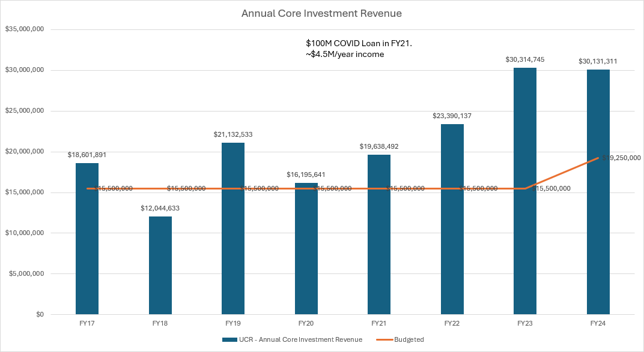
CAMPUS CORE BUDGET GROWTH
Investment Revenue has allowed recent increases to our Core Budget
An additional $5.8M was added to FY25 Core Funds bringing our total core budget from investment income to $25M annually.
Notes:
Gerry

Slide 21
CAMPUS CORE BUDGET PLANNING
FY26 Budget Planning
Prepared for a more challenging year relative to state funding
  The State Legislature has indicated a 7.9% budget reduction for UC
  We have a perm balance in FY25 that will carry forward into FY26 to help offset reductions
The Governor will present his FY26 State Budget in January
  We will have insight into UC’s budget
  Possibly higher state revenues will allow for a lower budget reduction to UC
Most of our state funding is driven by enrollment
  Our recent declines in enrollment compared to other UCs will result in a budget reduction to UCR
  It is very important to have Fall 2025 enrollment back at Fall 2021 level
Notes:
Gerry

Slide 22
QUESTIONS OR COMMENTS?
Notes:
Gerry and Stephanie

