Slide 1
UCR BUDGET AND FINANCIAL FUNDAMENTALS
NOVEMBER 1, 2023

Slide 2
CAMPUS BUDGET OVERVIEW
Revenue and Expenses in FY22-23
~$1.2 billion total revenues and expenditures
  Core revenue (state funds, tuition) plus Student Fees, Contract & Grants, Gifts, Sales & Service, and Auxiliary Services.
~$712 million core revenues and expenditures
  Core revenue (state funds, tuition, F&A) used to fund the teaching and research operations for the campus
Projected Revenue and Expenses for FY23-24
~$1.3 billion total budgeted revenues and expenditures
Core Budget plus Student Fees, C&G, Gifts, Sales & Service, and Auxiliaries
~$748 million core budgeted revenues and expenditures
Core used to fund the teaching and research operations for the campus

Slide 3

CAMPUS BUDGET OVERVIEW
FY23 All Funds Revenue and Expenditures
Salaries & Benefits make up 75% of total expenses

Slide 4
CAMPUS BUDGET OVERVIEW
FY23 Core Revenue and Expenditures

Slide 5
CAMPUS BUDGET OVERVIEW
UCR Major Revenue Streams over time
HEERF Funds
In thousands

Slide 6
CAMPUS BUDGET OVERVIEW
UCR Major Revenue Streams over time – Zoom in view of revenue streams under $50K
In thousands

Slide 7
BUDGET MODEL – DRIVERS

Slide 8
CAMPUS BUDGET OVERVIEW
UCR Major Core Revenue Flows
Inflow
Student Tuition (excludes Self- Supporting)
Driven by enrollment
Regent Tuition Increases approvals
State Funding (through UCOP)
Driven by State
Includes set-asides
Non-Resident Tuition
Driven by enrollment of out-of-state and international students
Waived for about 50% of students per UCOP policy (CA HS graduates, etc.)
F&A
Distributed through UCOP Rebenching
Based on Budgeted Student FTE
Reduced by student discounts
Driven by Contract and Grant activity
Realized rate is about 50% of the approved rate
Outflow
Org Base Budgets
Undergrad Financial Aid and Scholarships
Graduate Student Stipends and Fellowships
Salary and Benefits Cost Increases
Tuition Allocations to Colleges and Schools
F&A Distribution Funding, Faculty Start-ups
Debt & Lease Payments
Campus-wide Projects (Banner, Financial System, UC Path)
Special Decisions

Slide 9
CAMPUS BUDGET OVERVIEW
UCR Major Core Revenue Variables
Tuition Increases
(excludes Self-Supporting)
Tuition and Non-Resident Tuition provide ~50% of our core revenues
State Funding Increases
State funding provides ~46% of our core revenues
Student Enrollment Growth
Additional tuition & state funds (offset by costs)
Tuition and Non-Resident Tuition changes require Regental approval
Based on FTE enrollment (average unit loads) and defined set-asides
Enrollment of self-supporting Masters & non-residents provide additional revenue
Negotiated by UCOP and CA Legislature, Governor
Based on Budgeted FTE, with occasional true-ups to actuals
Limited by current human and capital infrastructure
01
02
03

Slide 10
CAMPUS BUDGET OVERVIEW
Major Core Revenue Variables
UCOP Rebenching Model
The UCOP process to allocate state funds to each of the campuses based on student enrollment (FTE of CA Residents)
UCOP also allocates state funds to “set-asides”
UCOP determines model and is implementing minor changes such as 1.5x weighting for UG students from LCFF high schools. FY24 is likely the last year UCR will receive funding to achieve the 95% level of the UC average for state funding per unweighted student.
04

Slide 11
CAMPUS BUDGET OVERVIEW
Major Core Revenue Variables
UCOP Assessment
Total assessment to UCR in FY22-23 = $21M
Fixed Cost Increases
Salary and Benefits for faculty and staff are the main drivers as well as other mandates from contract increases
UCOP determines model
UCOP “charges” each campus an assessment fee to fund their central operations and has also transferred expenses previously covered by their budget as separate charges to campuses (UCDC, Library costs, etc.)
This is how UCOP gets their annual operating budget
05
06

Slide 12
CAMPUS BUDGET OVERVIEW
UCR’s FY23 State Permanent Budget with Set-Asides Noted
Description | UCR Amount | Location
Agricultural Exp Stations (Ag Ops) | $35,532,546 | UCB, UCD, UCR (set-aside currently adjusted for inflation)
SAPEP | $689,323 | All campuses (set-aside currently adjusted for inflation)
SAPEP – Rotating | $1,620,250 | All campuses (Perm funding reallocated between campuses every 3 years)
Fixed Cost Set-Aside | $15,000,000 | Rebenching Campuses (all campuses except UCM and UCSF)
Unweighted Bud Enrollment (95% UC avg) | 13,539,794 | UCR, UCSC, UCSB
SOM | $40,000,000 | UCR Only
Multi-Campus Labor Center Initiative (CHASS) | 500,000 | UCD, UCI, UCR, UCSC (UCB, UCLA, UCM received $3M each)
Improve Grad Rates | $1,600,000 | UCM, UCR, UCSC, UCSB
Dream Loan Program | $380,000 | All campuses
Student Basic Needs | $1,240,000 | All campuses
Student Rapid Rehousing | $307,000 | All campuses
Student Mental Health | $2,139,000 | All campuses
Former Foster Youth | 734,000 | All campuses
Carceral System Impacted | 424,000 | All campuses
Undocumented Student Services | 594,000 | All campuses
Common Learning Mgmt System (Canvas) | 106,900 | All campuses
Summer FA | 595,000 | All campuses
Faculty Hiring Incentive Program | $1,105,000 | All campuses (3-year Perm funding reallocated between campuses for each award cycle)
USAP Financial Aid Program | $761,000 | All campuses (Perm funding reallocated between campuses every year)
UCR State Funding from set-asides | $119,162,813
UCR’s State Funding based on Enrollment | $235,381,482 | Rebenching Funds which are adjusted for inflation with state funds
UCR’s Total FY23 State Perm Budget* | $355,309,295
This is only the perm core funding from the state and does not include any carryforward or temp.
*Does not include the $4.3M Perm Budget for Alianza UCMX

Slide 13
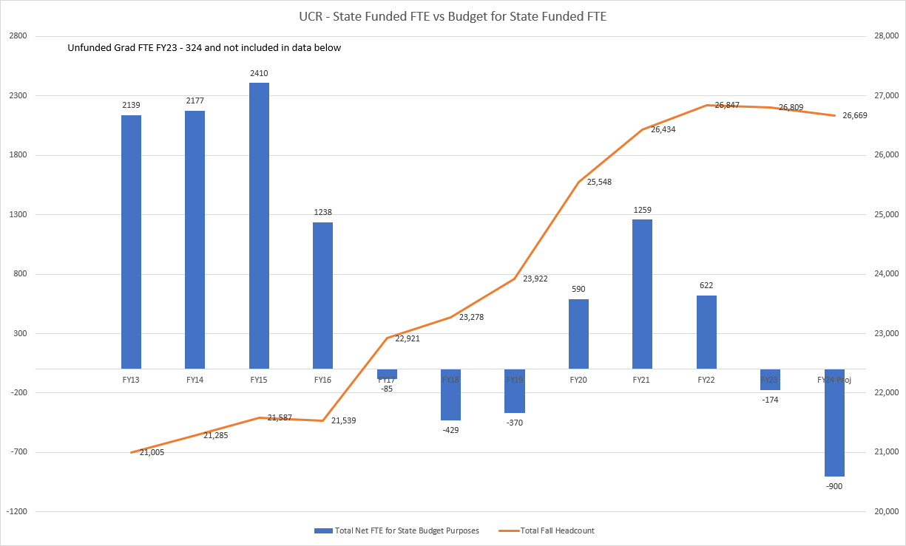
CAMPUS BUDGET OVERVIEW
State Funding is dependent on a Campus meeting the UCOP approved budgeted student FTE targets

Slide 14
CURRENT BUDGET MODEL – REVENUE DISTRIBUTION

Slide 15
REVENUE DISTRIBUTION
Distribution of Tuition & Non-Resident Tuition based on Enrollment Growth
Approved Modifications
FY19-20 - The UG NR Tuition percentages formula adjusted from 70%-to-30% for Colleges & Schools and 30%-to-70% for Campus Central Resources. These are the updated percentages as of FY23.
FY22-23 – The UG tuition formula implemented weighting on UG workload and UG NRT. In order to smooth the budget adjustments to Colleges & Schools, the Workload and Headcount was averaged between the unweighted prior year (FY22) and the weighted current year (FY23).
Prior to the Budget Model, all of the College & School funding went to the Campus Central Resources and allocations were made during the annual budget process based on unit budget proposals.
In Budget Model, the tuition value is $11,220 and the NR tuition values is $29754. Any tuition increases go to central resource to cover fixed cost increases.

Slide 16
REVENUE DISTRIBUTION
Distribution of Tuition & Non-Resident Tuition based on Enrollment Growth
Approved Modifications
FY22-23 – The Grad tuition formula implemented weighting on Grad tuition and Grad NRT. In order to smooth the budget adjustments to Colleges & Schools, the Workload and Headcount was averaged between the unweighted prior year and the weighted current year. (SOM is excluded from weighting.)
Prior to the Budget Model, all of the College & School funding went to the Campus Central Resources and allocations were made during the annual budget process based on unit budget proposals.
In Budget Model, the tuition value is $11,220 and the NR tuition values is $15,102 (Grad Masters)/$12,245 (Grad Prof). There have not been or are there planned tuition increases on Graduate level NR tuition.
All Financial Aid above goes to Grad Division to support PhD students.

Slide 17
REVENUE DISTRIBUTION
Distribution of Tuition & Non-Resident Tuition based on Enrollment Growth
SSGDP and PDST programs are responsible for the Financial Aid set-asides from their revenue and should maintain the terms in the fee proposals submitted to UCOP and approved by the Regents
Prior to the Budget Model, all of the College & School funding went to the Campus Central Resources and allocations were made during the annual budget process based on unit budget proposals.
In Budget Model, the tuition value is $11,220 and the NR tuition values is $15,102 for PhD students.
PDST Financial Aid must be spent on Professional Masters Students only.

Slide 18
CAMPUS CORE BUDGET IN ORGS

Slide 19
CAMPUS CORE BUDGET
Core Budget Summary as of 7/1/23
Core Budget includes:
State General Funds
UC General Funds
Tuition
Student Services Fee
Non-Resident Tuition
F&A (new as of 7/1/22)
Note: Funding for the salary/benefit cost increases effective 7/1 and 10/1 are not reflected in Org balances since they are allocated based on actuals.
*Does not include the estimated FY24 State allocations yet

Slide 20
QUESTIONS OR COMMENTS?

