Slide 1

CBR Mitigation

Slide 2
Susana
History
  First CBR mitigation cycle happened during FY19 using the December 2018 snapshot.
  An extensive exercise was done by our prior AVC to review benefit budgets at the org level.
  BEAs were reviewed for the 3 years prior to see why any perm budgets were reduced or moved outside of the benefit BC’s.
  After establishing the appropriate baseline, central campus pulled back any perm benefit budgets related to unfilled positions.
  The intent going forward is to fund Orgs, through the mitigation process, for any vacant positions they filled that we had pulled back funding for and to ensure that we adjusted budgets accordingly for either raising or reducing CBR rates for the existing filled positions.

Slide 3
Jesus
Definitions
  Core Funds
  For CBR mitigation, these include funds 19900, 19912, 19924, 19942, and 67000.
  Benefits Pool
  The Benefits Pool is owned and managed by the Central Budget Office (CBO) and includes all permanent funds in benefit budget categories (BC20 and BC30) within core funds. Any budget in BC20 and BC30 across these funds is part of the Benefits Pool, regardless of other COA elements like activity, function or flexes. Please note that BC76 no longer allows perm budget, you can use it to cash manage saving or unallocated temp benefits but no perm budget can be posted to BC76.
  Employee Benefits Base Budget
  The estimated permanent benefits budget needed by an Org on July 1 to cover the costs of benefits for filled positions on core funds. The CBO uses the mitigation process to estimate this base budget for each Org.

Slide 4
Jesus
Process Overview
  The process aims to set the permanent benefits base budget for each Org for the next year.
  To determine this, the CBO takes a snapshot of filled and vacant positions on core funds, utilizing a calendar year view of benefit budgets rather than a fiscal year view, with the date of the snapshot incorporating major staff and faculty salary increases and actions that typically occur on July 1 and October 1. Therefore, the snapshot date is the last working day of December.
  After units review and edits are made to the snapshot, the CBO applies CBR rates for the next fiscal year to estimate the next year’s employee benefit costs. The CBO will then allocate or pullback funds from the benefits pool that is held with the Org to align the unit’s base budget with the estimate.

Slide 5
Jesus
Components of Mitigation Process
  Staffing Snapshot
  A point-in-time snapshot of BDP data for filled and vacant core-funded positions, typically taken at the end of December to capture major salary actions. Orgs must review and certify the accuracy of the snapshot, as it is the sole basis for estimating next-year CBR costs. Changes made after the snapshot date are not captured and must be cash-managed until the next cycle.
  CBR Mitigation Recon Template
  Used to identify Org-funded salary changes and FTE increases that are not centrally funded (e.g., retentions, promotions, reclassifications, new positions). Orgs must permanently budget for both salary and related CBR costs by moving funds into the appropriate benefits pool (BC20 or BC30). The template calculates any benefits funding the Org is responsible for contributing and distinguishes these costs from those funded by the CBO.
  Mitigation Table
  Combines the recon template and staffing snapshot to compare an Org’s current benefits budget to the projected CBR costs for filled core FTE in the next fiscal year. The difference determines the mitigation amount: CBO provides permanent funding if costs exceed the budget or pulls funding if costs are lower.

Slide 6
Jesus
Key Takeaways
  Units should not move permanent benefits funds out of the benefit pool, as these are not discretionary funds for the Org. Permanent funds can be transferred between activities but must remain in BC20 or BC30. Exceptions include re-orgs where funds need to shift due to an entire activity, department, or division moving from one org to another (but staying within the benefit BCs) and/or approved budget cuts managed by FP&A.
  Units should allocate perm funds into the pool for salary actions that are not funded by the CBO (e.g., retentions, promotions, reclassifications). The recon template is how units communicate and differentiate between Org-funded salary changes and those funded by the CBO.
        For example, if a unit creates a position from S&E funds, they must permanently budget for the full salary and benefits. Once the position's budget is established, the central budget will cover future salary increments for centrally funded actions.
  The mitigation process captures a snapshot in time. It’s possible that a position becomes filled or vacant shortly after. The unit is responsible for cash management of these changes but should not adjust the permanent budget. These changes will be captured in the next mitigation round, and the CBO will fund the position in the new year.

Slide 7
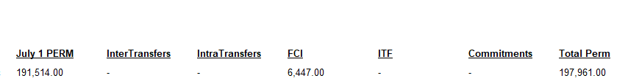
Jesus
Oracle Report: Perm Core Benefit Transfers
  This report showcases all PERM budget allocated to benefit Budget Codes (BCs) for the five core funds utilized in CBR mitigation. It delineates the sources of the PERM budget, including July 1 PERM, Intra/Inter Transfers, FCI transfers, and other relevant categories.
Unit Actions
CBO Actions

Slide 8
Jesus
Staffing Snapshot Updates
  This year, staffing snapshots are to be finalized before recon templates are distributed
  Reflects UCPath Budget Distribution Page (BDP) data extracted on December 23, 2025.
  Staffing Snapshot workbook sent to CFAOs on January 11
  Permitted changes to the snapshot are limited to:
      Position budget and FTE
      Position status (filled or vacant)
      Funding source (core vs. non-core)
  Rows cannot be added. If a position is missing due to a system issue, such as being dropped from BDP, Orgs must request it be added using the separate tab included in the workbook

Slide 9
Jesus
Other Considerations
  The staffing snapshot is how the Org communicates active positions that it will need perm benefits funding for. Therefore, if you have a position that you have permanently budgeted but is not currently active, please be sure to “Eliminate” the position from the Snapshot.
  Temporary Appointments
  Employees may hold more than one appointment but should never have more than 1.0 active FTE. If an employee has an inactive core-funded position (for which they are not currently paid out of) and a temporary or active core-funded position within the same or another Org, benefits funding is provided only for the active position.

Slide 10
Jesus
Important Dates and Deadlines
  January 22: Deadline to submit Staffing Snapshot Changes
    No changes can be made to the staffing snapshot past this date and are final.
  January 22-28: CBR mitigation templates distributed to Orgs
  January 30: Second CBR meeting to go over mitigation templates
  February (TBD): Deadline to submit CBR Mitigation Templates

Slide 11
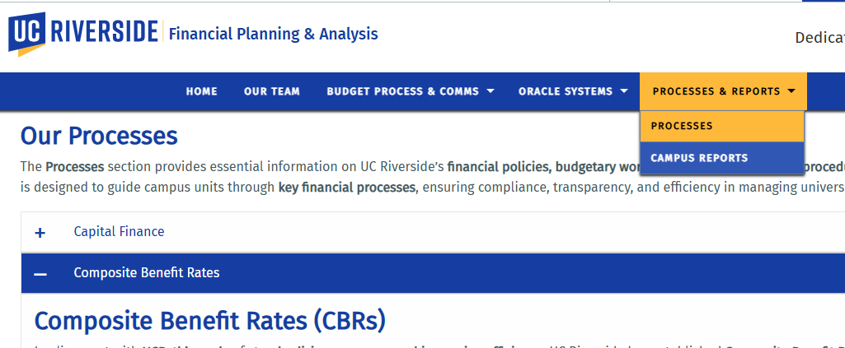
Jesus
Resources
  Visit fpa.ucr.edu for more information on CBR.

